Slide 1
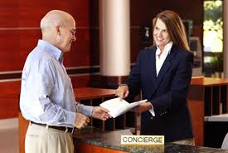

Hotel Staff
Feedback
Project 3, Group 6, DSI13
Elton, Jason and Joey

Slide 2
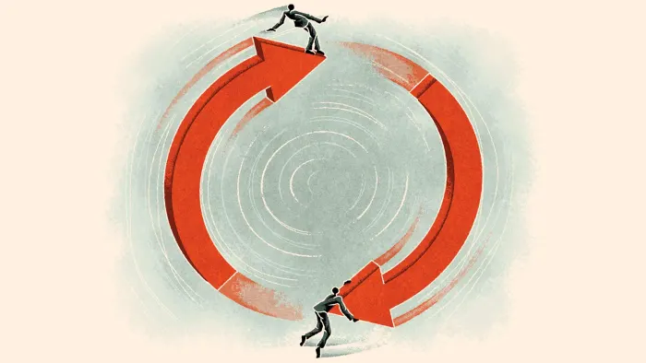
Context and Problem Statement
We are the American Hotel and Lodging Association.
In recent years, frontdesk staff at hotels have been leaving due to increased workload.
Vicious cycle - as frontdesk staff decrease, workload increases for remaining staff, who then leave etc.
Affected customer experience at front desks.
Notes:
Of two subreddits (talesfromyourserver and talesfromthefrontdesk), to determine whether a post belongs to talesfromthefrontdesk or not.
There is a strong need to stem this outflow of frontdesk staff by understanding their concerns and improving their working conditions.

Slide 3
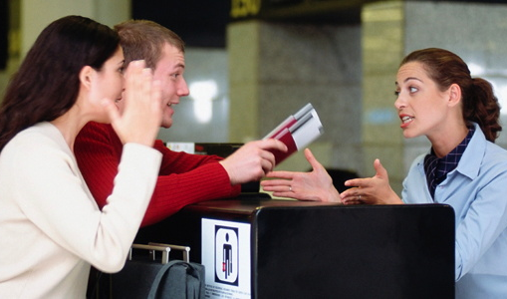
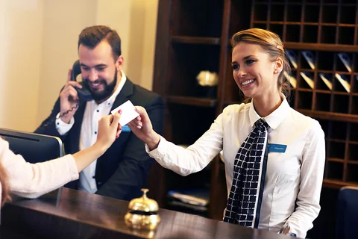
Context and Problem Statement
We currently have access to annual feedback from hotel staff (including our servers in the ballrooms and restaurants, staff at the frontdesk etc.)
We want to zoom in to problems from frontdesk staff only, so that we can quickly stop the vicious cycle of such staff leaving, and service standards declining.
Production Model > 90% Accuracy!
Notes:
Given the urgency, we are turning to data science to classify the feedback and help us to identify whether a piece of feedback is from frontdesk staff or not.

Slide 4
Data Cleaning
Removed duplicates
Removed moderator message
Advertisements were not found in the scraped data
Treatment of posts with text in the title, but no text in the body - joined body (“selftext”) and title of all posts to create a new column
Notes:
We assumed that the text in the title would be important (they could be short messages with pertinent content), and did not delete such posts with no text in the body; instead, we combined the title and body of each post before further analysis/processing.

Slide 5
Preprocessing
We created a function to preprocess the text. The function helped to:
remove any ‘http’
remove non-letters and split the text into just words so that they can be processed
convert all letters to lower case
get rid of word variations of same root meaning - lemmatization
remove stop words from a pre-determined and customized set
re-join words back into text for EDA
Notes:
(Jason)

Slide 6
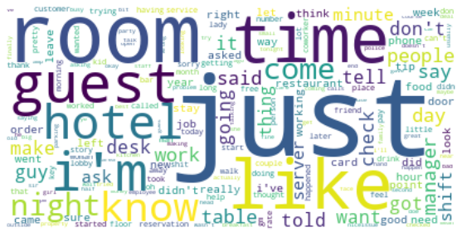
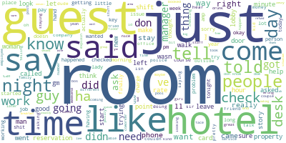
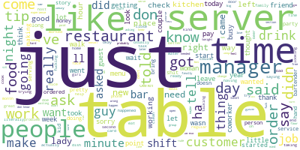
EDA
Combined (server + frontdesk)
Server
Front Desk
Notes:
(Jason)

Slide 7
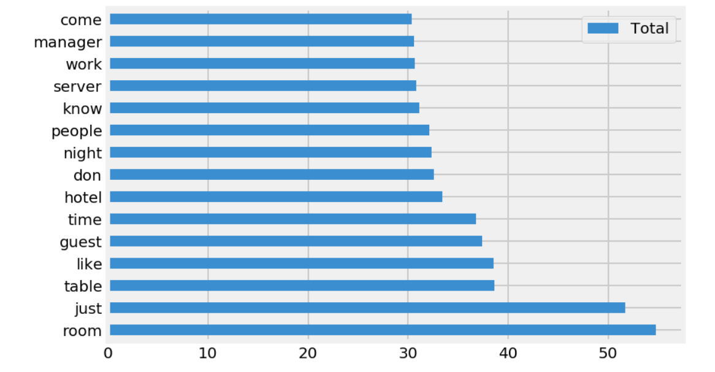
Modelling Process
Naive Bayes and Logistic Regression.
For each model,
CountVectorizer (cvec) and TfidfVectorizer (tvec) to vectorize texts into word tokens (compatible with modelling)
Eg.: Word weightage for X_train after tvec treatment:
Notes:
Cvec - word count
Tvec - term frequency-inverse document frequency (discriminating power)

Slide 8
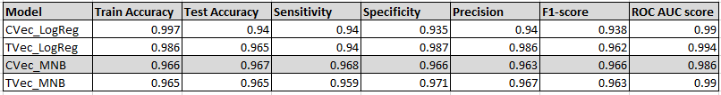
Model of Choice - Comparison of Model Results
Multinomial Naive Bayes with Count Vectorizer
Notes:
Based on the results tallied above, the production model chosen is the TVec_MNB model. All 4 models have very high scores across all categories (>90). However, as false negatives are more important than false positives here, a high Sensitivity indicating low false negatives is most desirable.
Thus the CVec_MNB model with the highest Sensitvity of 0.968 while still having an accuracy of 0.967 on test data is deemed the model that best solves our problem statement. It is also robust and will generalise well on unseen data, as its test accuracy is higher than its train accuracy of 0.966.
Both CVec and TVec LogReg models have test accuracy 2-3% lower than their train accuracy which is very high, compared with the other models. This indicates overfit, and thus makes them a less favourable choice.
The TVec_MNB model is weaker than the CVec_MNB model is all categories execpt for Precision and ROC AUC score, which is scores slightly better. This indicates that the TVec_MNB model could be better at sorting out unbalanced classes, but as our data is relatively balanced here, CVec_MNB is the preferred choice.

Slide 9
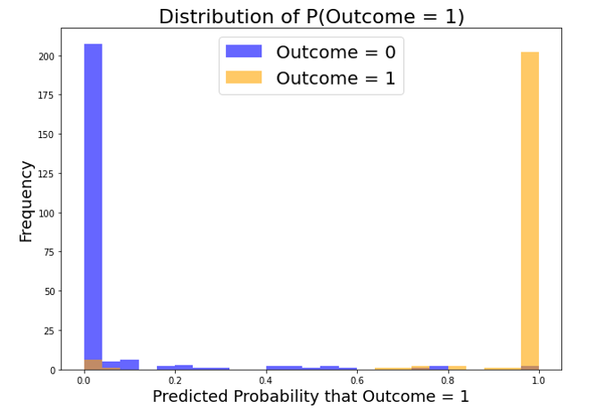
Model of Choice - Prediction Probabilities Distribution
Notes:
Predicted Probabilities show clear decisions made by the model. It confidently predicts either class with a high probability.
We see that the frequency of the predictions are balanced, which reflect well on our model due to the classes being actually balanced.

Slide 10
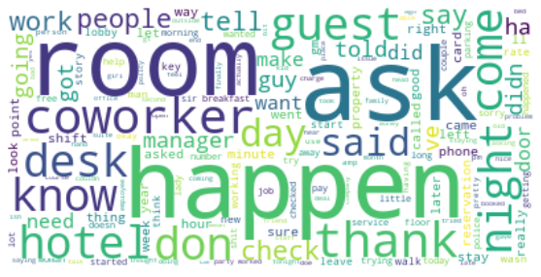
Model Interpretation - Visualization
Pre-Model Wordcloud Production Model Wordcloud
Notes:
See certain words have diminished in relevance, others have become more prominent.

Slide 11
Conclusion and Recommendations
CVec_MnB model (Accuracy 0.965) >> Baseline Model (Accuracy 0.522)
CVec_ MnB model (Accuracy 0.965) > Problem Statement (Accuracy 0.9)
Improved Model
More Data
Meanwhile...
Better Morale
Business Gain
Notes:
This model will be able to process hotel staff feedback automatically, and separate out the desired frontdesk staff feedback with a very high accuracy, with low false negatives.
CVec_LogReg model (Accuracy 0.965) is vastly better than the Baseline Model (Accuracy 0.522) and it has also succeeded in fulfiling the problem statement's >.90 accuracy requirement stated earlier.
Given the high performance of the model, we look forward to seeing the results of quick management action which will reduce frontdesk staff turnover, increasing morale and service standards, leading to increased customer satisfaction from better service.
A study could be done 6 months later to check the gain of the model.
Alternatively, more data could be gathered to improve the model on an ongoing basis, with results being compared on a monthly basis.

Slide 12
Conclusion and Recommendations
CVec_ MnB model (Accuracy 0.965) >> Baseline Model (Accuracy 0.522)
CVec_ MnB model (Accuracy 0.965) > Problem Statement (Accuracy 0.9)
Improved Model
More Data
while!
Better Morale
Business Gain
Notes:
This model will be able to process hotel staff feedback automatically, and separate out the desired frontdesk staff feedback with a very high accuracy, with low false negatives.
CVec_LogReg model (Accuracy 0.965) is vastly better than the Baseline Model (Accuracy 0.522) and it has also succeeded in fulfiling the problem statement's >.90 accuracy requirement stated earlier.
Given the high performance of the model, we look forward to seeing the results of quick management action which will reduce frontdesk staff turnover, increasing morale and service standards, leading to increased customer satisfaction from better service.
A study could be done 6 months later to check the gain of the model.
Alternatively, more data could be gathered to improve the model on an ongoing basis, with results being compared on a monthly basis.

